Slide 1

19CS2109
Computer Networks And Security
The Transport Layer UDP/TCP

Slide 2
The Internet Transport Protocols: UDP
Introduction to UDP
Remote Procedure Call
The Real-Time Transport Protocol

Slide 3
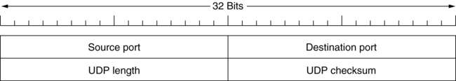
Introduction to UDP
The UDP header.

Slide 4
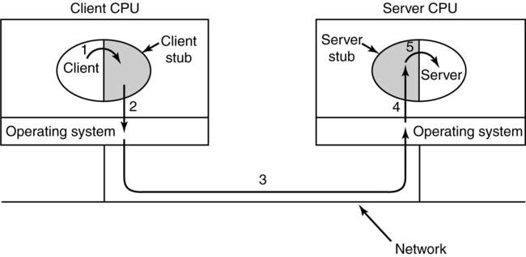
Remote Procedure Call
Steps in making a remote procedure call. The stubs are shaded.

Slide 5
The Internet Transport Protocols: TCP
Introduction to TCP
The TCP Service Model
The TCP Protocol
The TCP Segment Header
TCP Connection Establishment
TCP Connection Release
TCP Connection Management Modeling
TCP Transmission Policy
TCP Congestion Control
TCP Timer Management

Slide 6
The TCP Service Model
Some assigned ports.
Port
Protocol
Use
21
FTP
File transfer
23
Telnet
Remote login
25
SMTP
E-mail
69
TFTP
Trivial File Transfer Protocol
79
Finger
Lookup info about a user
80
HTTP
World Wide Web
110
POP-3
Remote e-mail access
119
NNTP
USENET news

Slide 7
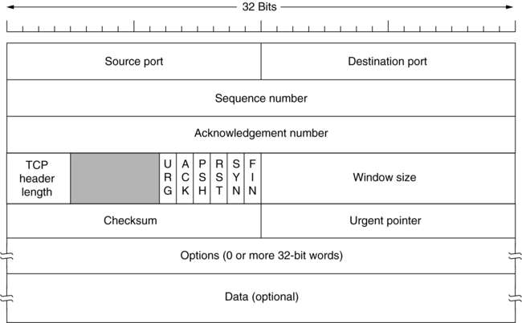
The TCP Segment Header
TCP Header.

Slide 8
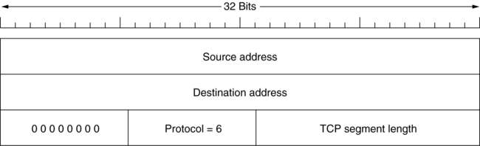
The TCP Segment Header (2)
The pseudoheader included in the TCP checksum.

Slide 9
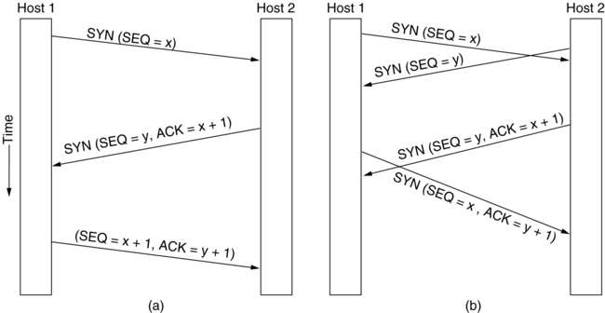
TCP Connection Establishment
6-31
(a) TCP connection establishment in the normal case.
(b) Call collision.

Slide 10
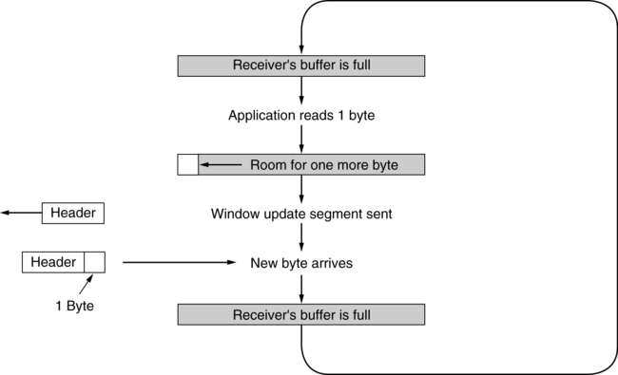
TCP Transmission Policy (2)
Silly window syndrome.

Slide 11
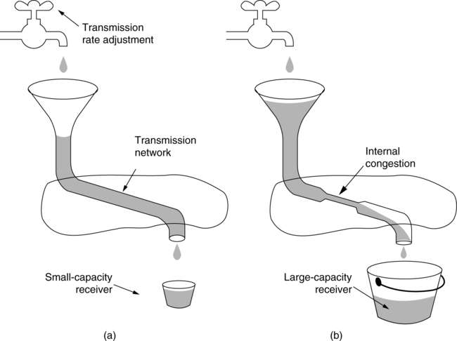
TCP Congestion Control
(a) A fast network feeding a low capacity receiver.
(b) A slow network feeding a high-capacity receiver.

Slide 12
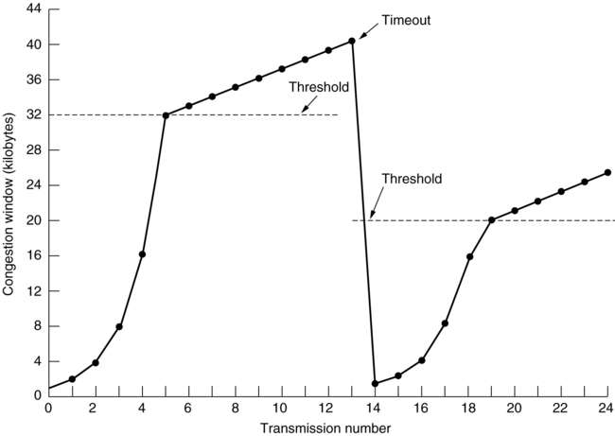
TCP Congestion Control (2)
An example of the Internet congestion algorithm.

Slide 13
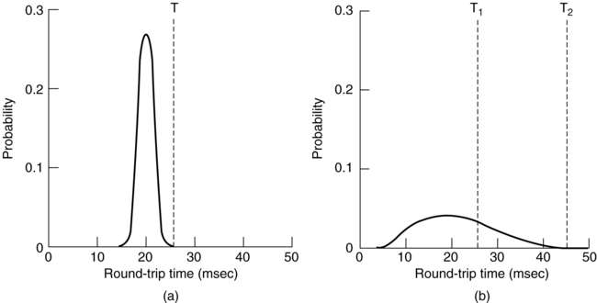
TCP Timer Management
(a) Probability density of ACK arrival times in the data link layer.
(b) Probability density of ACK arrival times for TCP.

